Slide 1
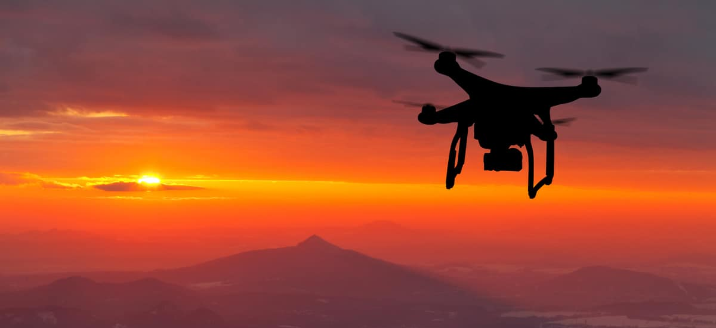
Team 508: Drone Payload Sample Collection
Design Review 6
Notes:
Size of Apparatus, Energy Usage, Aerodynamic Drag Force, and Weight Distribution

Slide 2
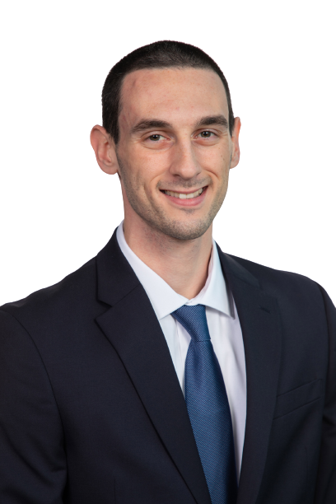
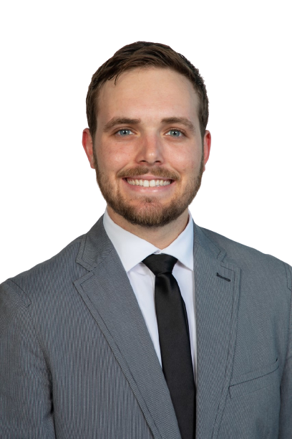
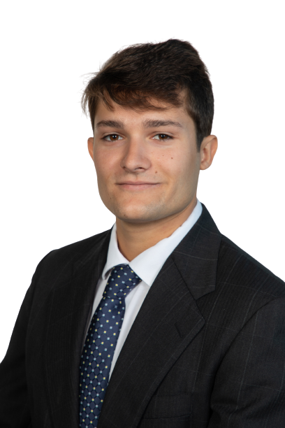
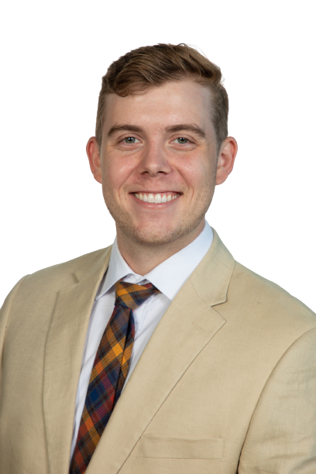
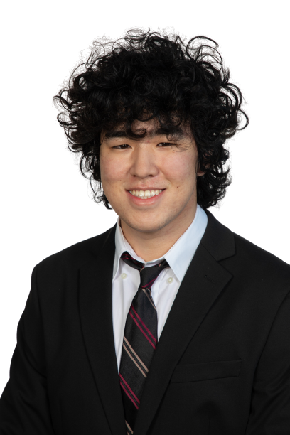
Team Introductions
Dominic Bellocchio
Design Engineer
Tauben Brenner
Manufacturing
Engineer
Roberto Lacasa
Programming
Engineer
Matthew Lancaster
Control Systems
Engineer
Dylan Ma
Mechatronics Engineer
Dominic Bellocchio

Slide 3
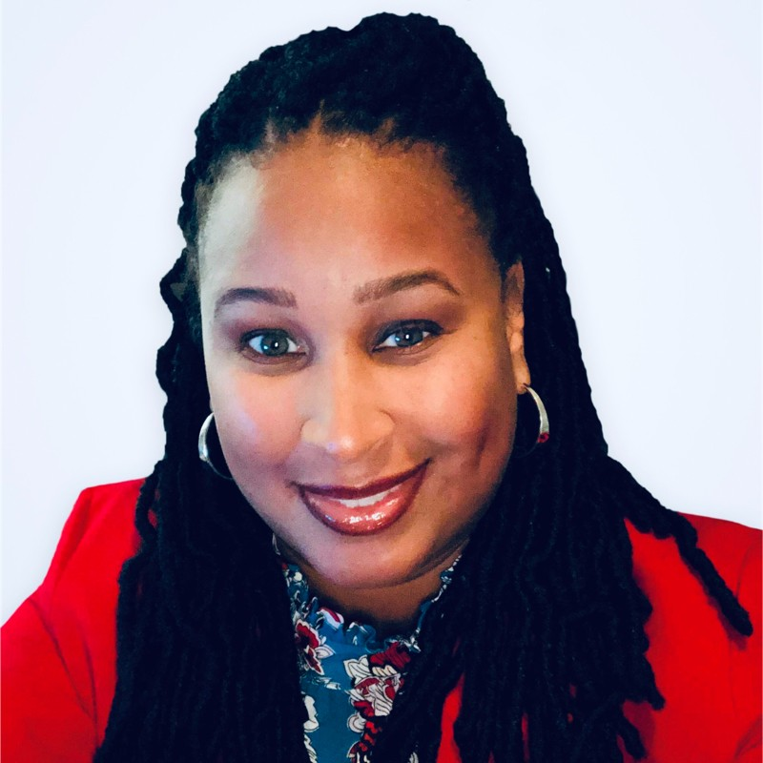
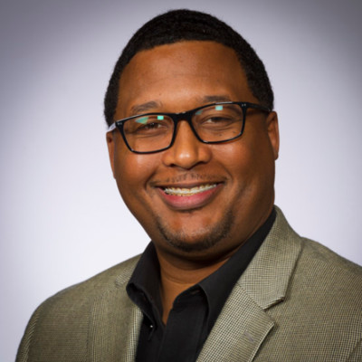
Sponsors and Advisor
Engineering Mentor
Alicia Washington
M&A Senior Project Manager
Dow Chemical
Engineering Mentor
Marcus Rideaux
Global Implementation Leader
Dow Chemical
Academic Advisor
Camilo Ordóñez, Ph.D.
ME Teaching Faculty
Florida State University
Dominic Bellocchio

Slide 4
Objective
The payload should collect liquid samples, prevent contamination, and store the samples safely
Dominic Bellocchio
Notes:
Give them a reminder of what our project is about.

Slide 5
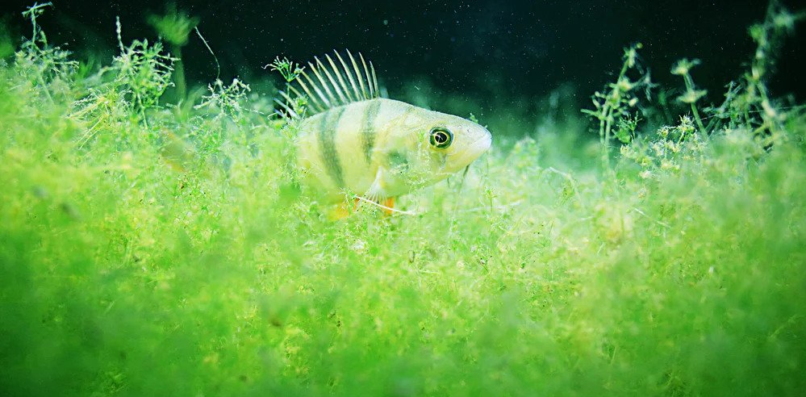
Project Background
Why sample algae blooms?
Dominic Bellocchio
Notes:
Why is this important? You have probably heard of red tide. Red tide is considered a harmful algal bloom, or HABs, these occur when colonies of algae grow out of control while producing toxic or harmful effects. Not all algae is bad. Algae is a major source of energy for the ocean food web.

Slide 6
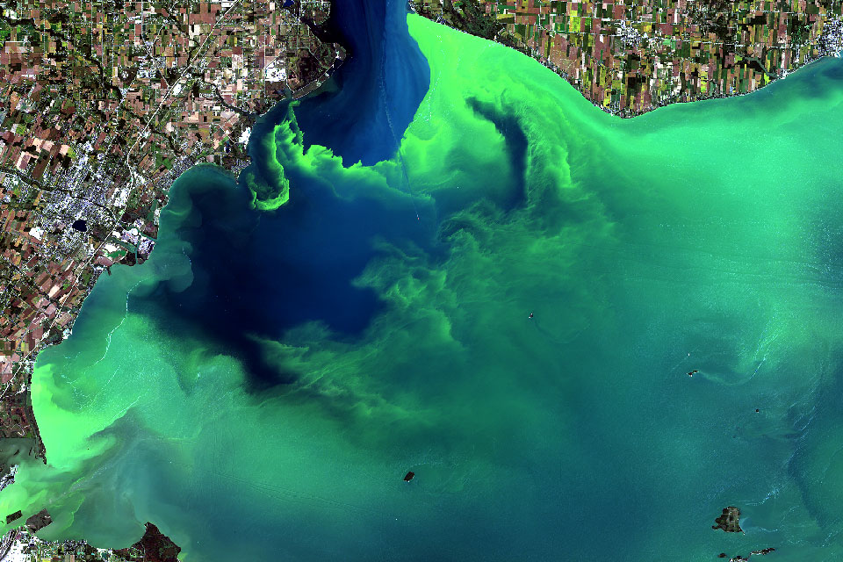
Project Background
The benefit of using a drone
Dominic Bellocchio
Notes:
Why use a drone? Drones are fast, you can take many samples over a large area, you can't use a boat because the boat will carry the algae on the hull,

Slide 7
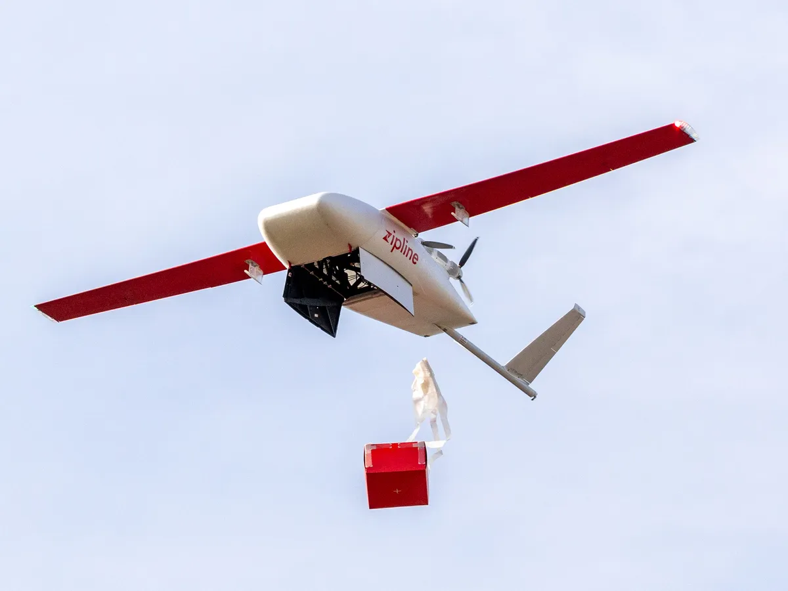
Current Market
Long range accurate drops
Delivering life saving medicine and blood
Drones in air in minutes
Dominic Bellocchio
Notes:
https://www.youtube.com/watch?v=DOWDNBu9DkU&t=273s
This is the plane that Is in Africa I think that delivers blood long distances and really fast. The video explains them both really well.

Slide 8
Project Requirements
Dominic Bellocchio
Notes:
We contacted a marine biologist with questions about collecting ocean samples for harmful substances to the environment.
We have received a response...
Tara specializes in testing for pathogens
Sample size requirements: 100 ml (100 g)
Sample collection requirements: keep it out of sunlight, UV light will harm validity of sample once it is taken (the natural conditions should be altered as little as possible when brought into the lab)
- surface collection is fine, since algae congregate at the surface level in dense portions.
Additional research resources: she told us to check out scholarly research articles related to our sample substances

Slide 9
Project Requirements
Collect and Store Multiple Samples
Dominic Bellocchio
Notes:
We contacted a marine biologist with questions about collecting ocean samples for harmful substances to the environment.
We have received a response...
Tara specializes in testing for pathogens
Sample size requirements: 100 ml (100 g)
Sample collection requirements: keep it out of sunlight, UV light will harm validity of sample once it is taken (the natural conditions should be altered as little as possible when brought into the lab)
- surface collection is fine, since algae congregate at the surface level in dense portions.
Additional research resources: she told us to check out scholarly research articles related to our sample substances

Slide 10
Project Requirements
Collect and Store Multiple Samples
Compact and Universal
Dominic Bellocchio
Notes:
We contacted a marine biologist with questions about collecting ocean samples for harmful substances to the environment.
We have received a response...
Tara specializes in testing for pathogens
Sample size requirements: 100 ml (100 g)
Sample collection requirements: keep it out of sunlight, UV light will harm validity of sample once it is taken (the natural conditions should be altered as little as possible when brought into the lab)
- surface collection is fine, since algae congregate at the surface level in dense portions.
Additional research resources: she told us to check out scholarly research articles related to our sample substances

Slide 11
Project Requirements
Collect and Store Multiple Samples
Compact and Universal
Does not
Impede Drone
Dominic Bellocchio
Notes:
We contacted a marine biologist with questions about collecting ocean samples for harmful substances to the environment.
We have received a response...
Tara specializes in testing for pathogens
Sample size requirements: 100 ml (100 g)
Sample collection requirements: keep it out of sunlight, UV light will harm validity of sample once it is taken (the natural conditions should be altered as little as possible when brought into the lab)
- surface collection is fine, since algae congregate at the surface level in dense portions.
Additional research resources: she told us to check out scholarly research articles related to our sample substances

Slide 12
Project Requirements
Collect and Store Multiple Samples
Compact and Universal
Does not
Impede
Drone
Light
&
Balanced
Dominic Bellocchio
Notes:
We contacted a marine biologist with questions about collecting ocean samples for harmful substances to the environment.
We have received a response...
Tara specializes in testing for pathogens
Sample size requirements: 100 ml (100 g)
Sample collection requirements: keep it out of sunlight, UV light will harm validity of sample once it is taken (the natural conditions should be altered as little as possible when brought into the lab)
- surface collection is fine, since algae congregate at the surface level in dense portions.
Additional research resources: she told us to check out scholarly research articles related to our sample substances

Slide 13
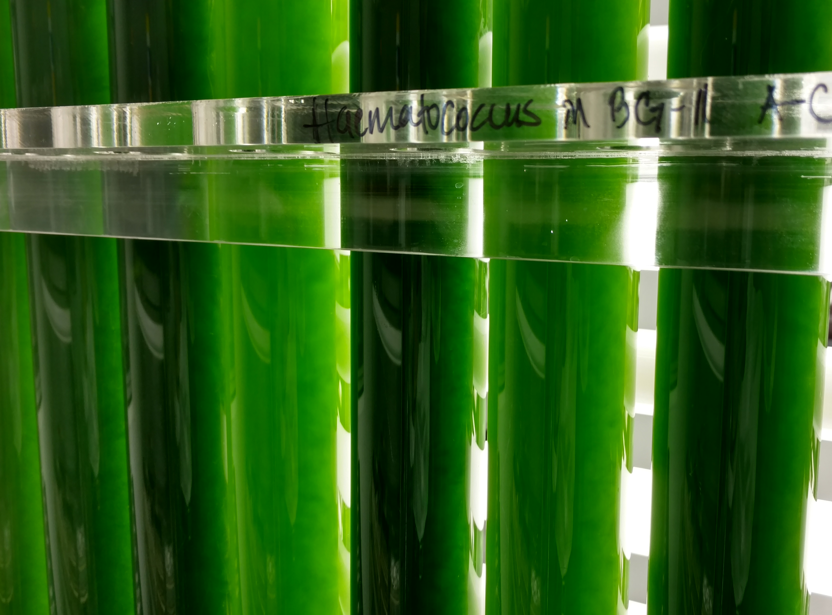
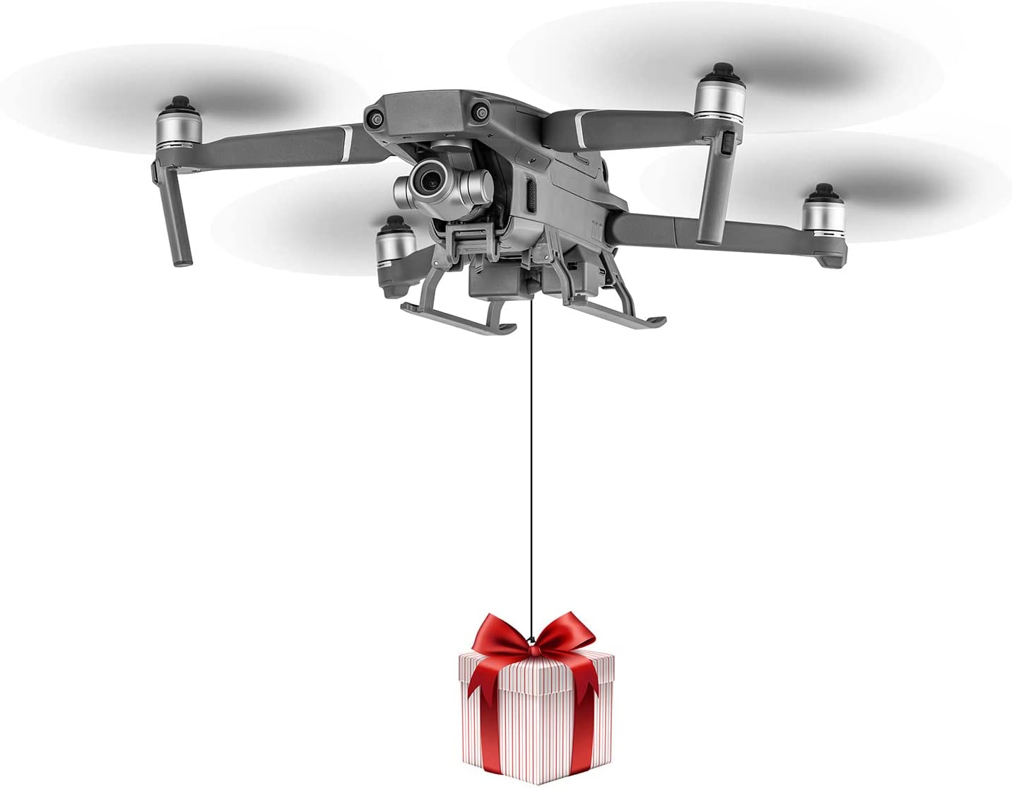
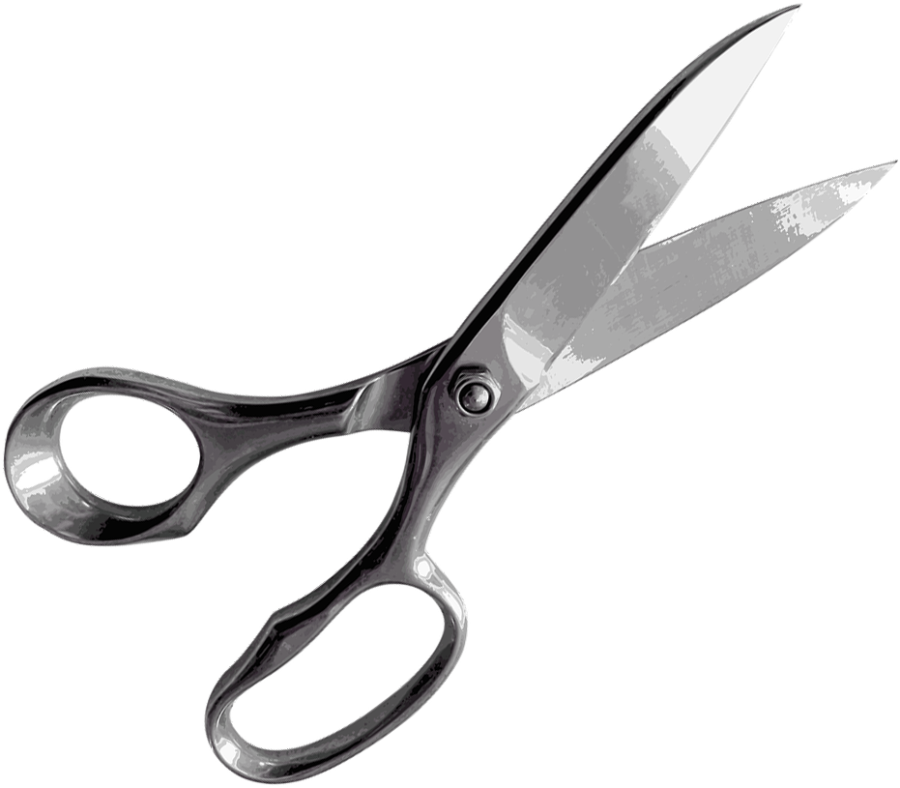
Design Targets
Volume
Force
Dominic Bellocchio
Notes:
Feedback – communication between the system and the user, it ties back into safety and stability.
The bottom line is that were are taking delicate and sensitive equipment into a chaotic and unpredictable environment, so mitigating disturbances is key.

Slide 14
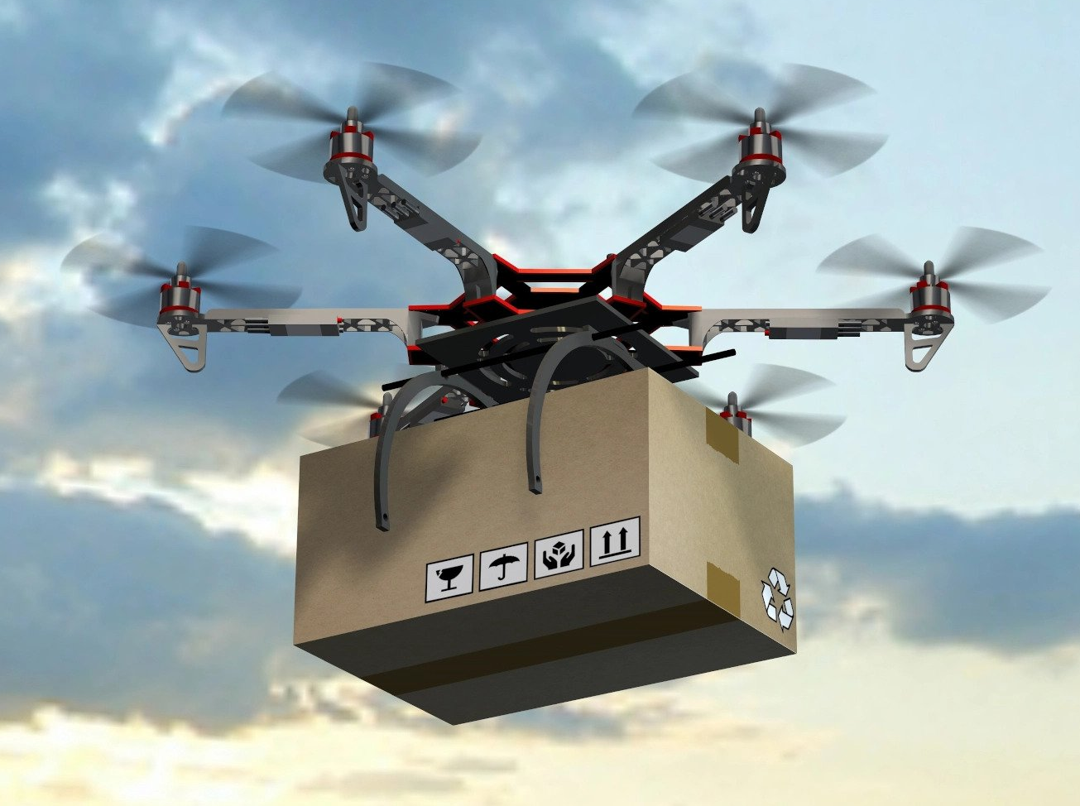
Design Targets
Mounting Methods
Weight Distribution
Dominic Bellocchio
Notes:
Feedback – communication between the system and the user, it ties back into safety and stability.
The bottom line is that were are taking delicate and sensitive equipment into a chaotic and unpredictable environment, so mitigating disturbances is key.

Slide 15
Concept Selection
Multiple Rooms
Can collect multiple samples
Adjustable number of rooms
Universal drone usage
Dominic Bellocchio

Slide 16
Dominic Bellocchio
Notes:
Essentially key goals slide. Universal attachment, collect samples, 1 kg payload, prevent contamination

Slide 17
Dominic Bellocchio
Notes:
Essentially key goals slide. Universal attachment, collect samples, 1 kg payload, prevent contamination

Slide 18
Dominic Bellocchio
Notes:
Essentially key goals slide. Universal attachment, collect samples, 1 kg payload, prevent contamination

Slide 19
Multiple mounting methods
Sample is released after exceeding max force
6 gram difference in weight distribution
Dominic Bellocchio
Notes:
Essentially key goals slide. Universal attachment, collect samples, 1 kg payload, prevent contamination

Slide 20
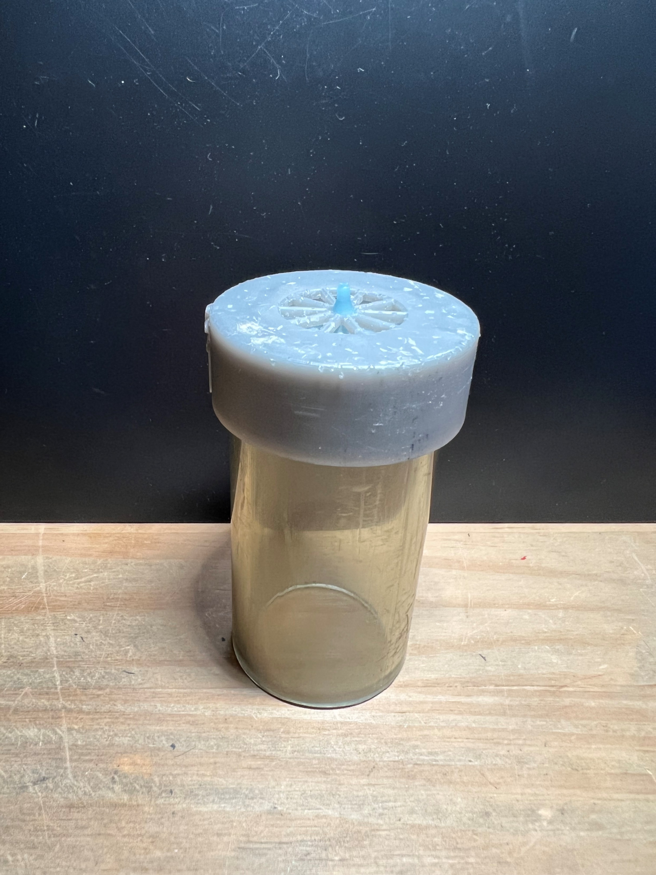
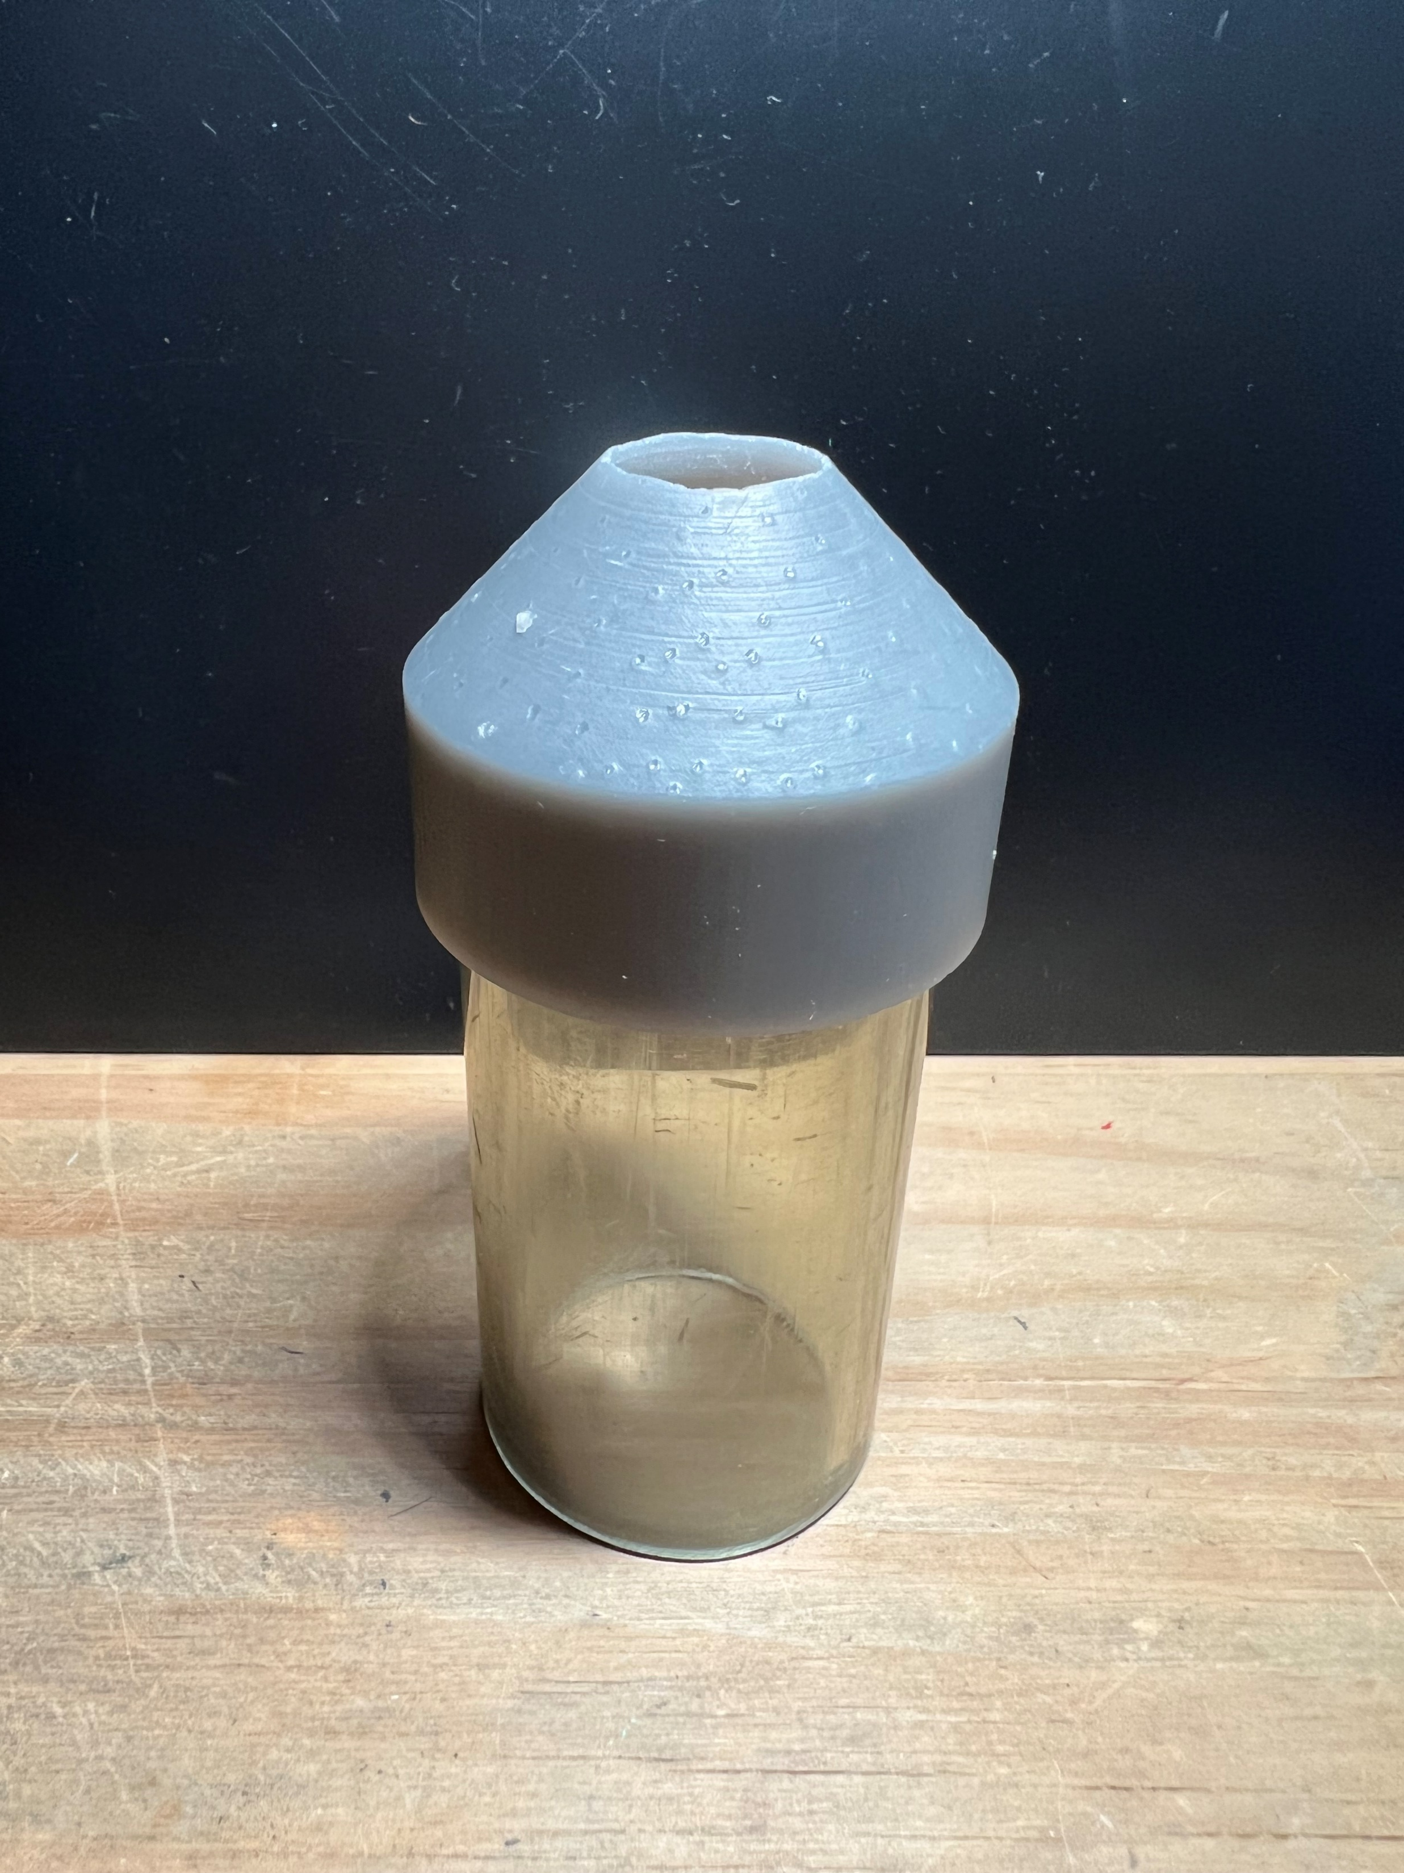
Design #1 Dimensions
122 mm
48.5 mm
Tauben Brenner

Slide 21
Design #1 Overview
One way cap doesn’t let solids in
Marble/rubber ball plugs hole
Funnel prone to leaking
Tauben Brenner
Notes:
One way cap based on snorkel valve, which lets water in through one direction but traps it from going the other way. Allows divers to breathe excess water out. Tried using a rubber ball and marble, and they either did not perfectly seal the hole or were too light to stop water from leaking fully.

Slide 22
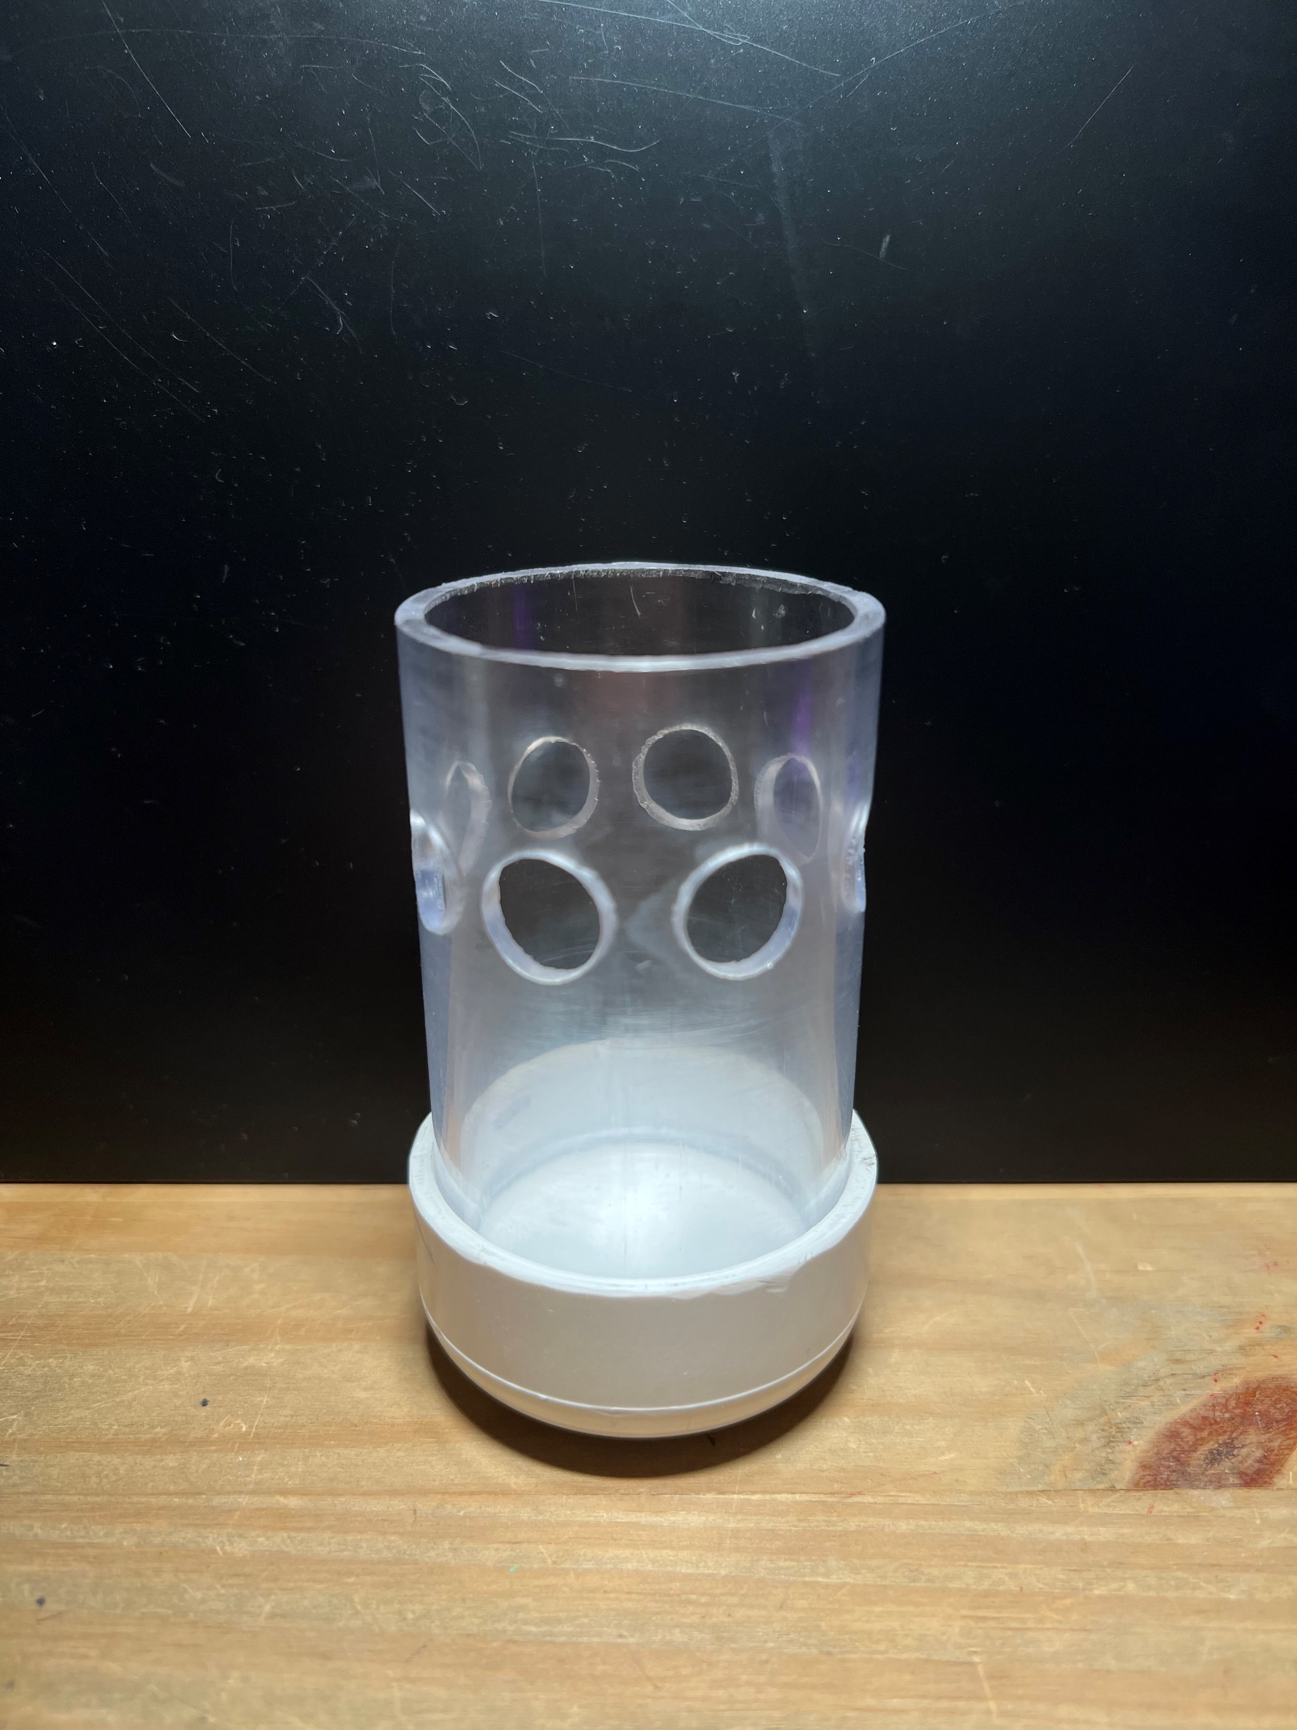
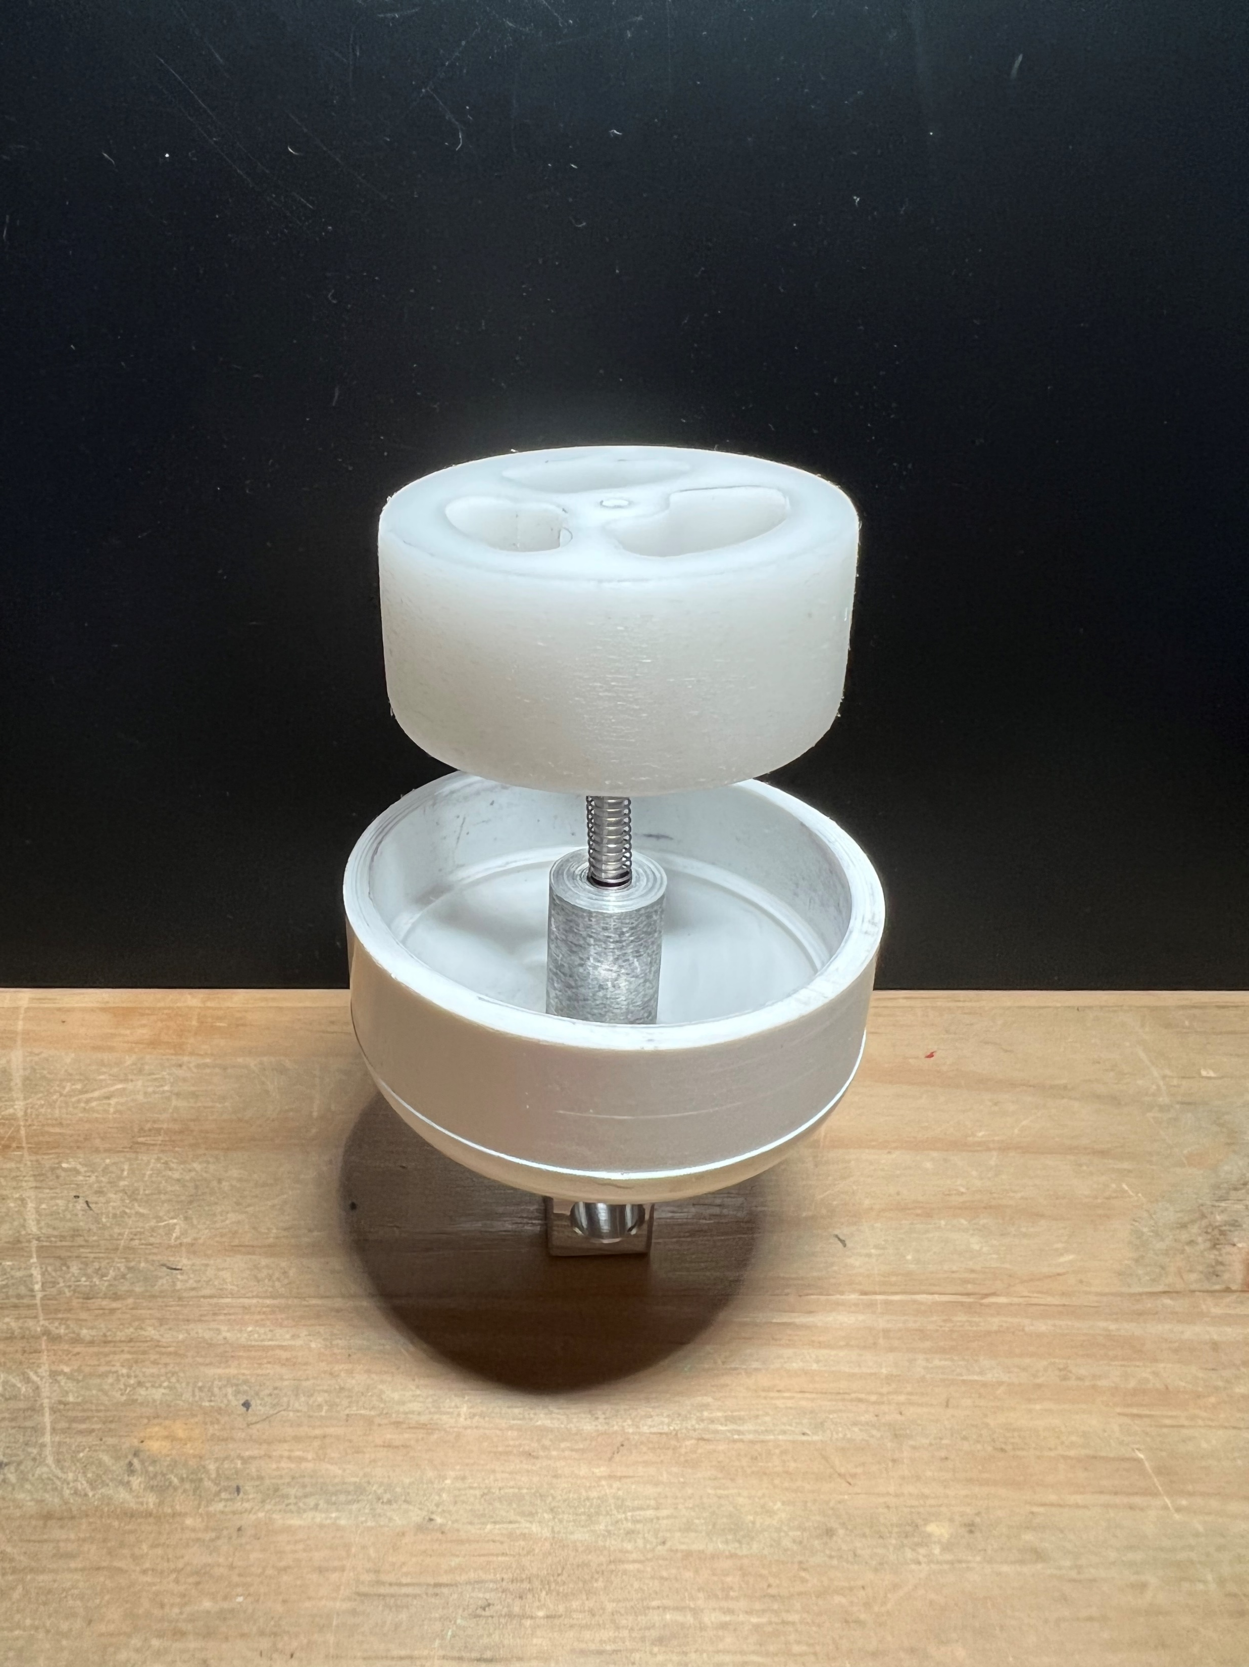
Design #2 Dimensions
133 mm
57 mm
Tauben Brenner

Slide 23
Design #2 Overview
Connects to outrigger clip
Holes allow water and algae inside (~80-90 mL)
Spring compresses to seal
Plunger allows water in from top but seals side
Smooth lid press fit
Tauben Brenner
Notes:
Notes: Doesn’t hold 100 mL of water, only around 80-90 mL max. Hard to extract sample for testing once collected. Lids are press-fit on. Add a valve or threaded lid on the bottom to unscrew. Want a corrosion resistant spring for multiple usages in water. Want a more tapered bottom cap to overcome surface tension upon contacting water. Plunger scrapes against walls slightly, decrease size.

Slide 24
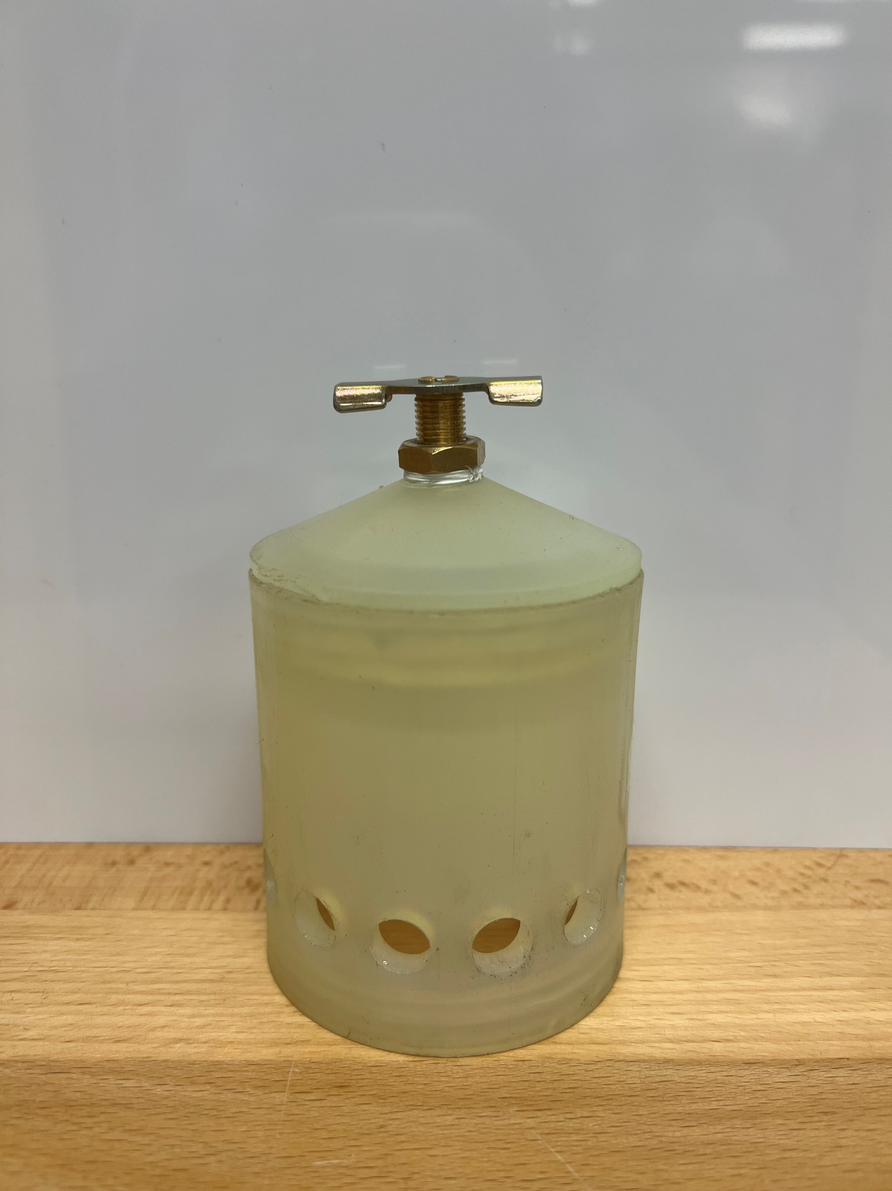
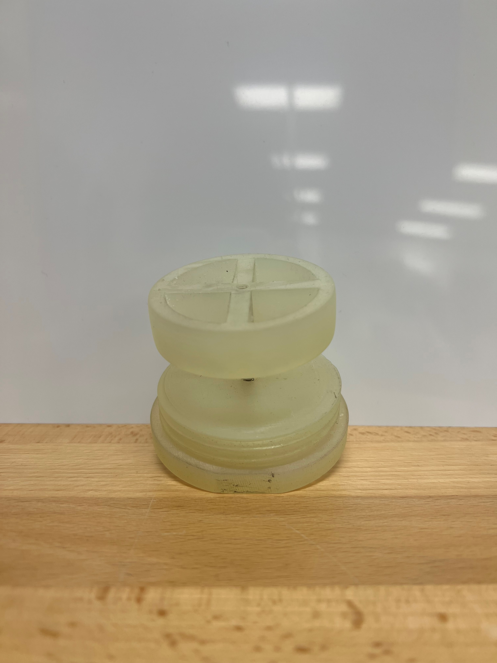
Design #3 Overview
135 mm
70 mm
Tauben Brenner

Slide 25
Design #3 Overview
10 mm holes; Resin container holds ~160 mL
Corrosion-resistant with higher spring constant
Larger holes but relative size of plunger was reduced
Threaded caps for security
Faucet valve releases water and algae
Tauben Brenner
Notes:
Material: Resin
New Features:
0.4 inch diameter holes
Faucet valve
Functional threading
Stronger spring constant
Weight: 240 g (empty)
Collection Capacity: 160 mL (~160 g)

Slide 26
Current Design Overview
110 mm
60 mm
Tauben Brenner

Slide 27
Current Design Overview
Material thickness reduced in plunger and cap
Same size ID, wall thickness reduced by 5mm
Weight reduced by 150 g
Removed threaded bottom cap for weight and leak reduction
PTFE tape at threaded valve for added leak resistance
Tauben Brenner
Notes:
Material: Resin
New Features:
0.4 inch diameter holes
Faucet valve
Functional threading
Stronger spring constant
Weight: 240 g (empty)
Collection Capacity: 160 mL (~160 g)

Slide 28
Interfacing Electronics
151 mm
186 mm
Dylan Ma

Slide 29
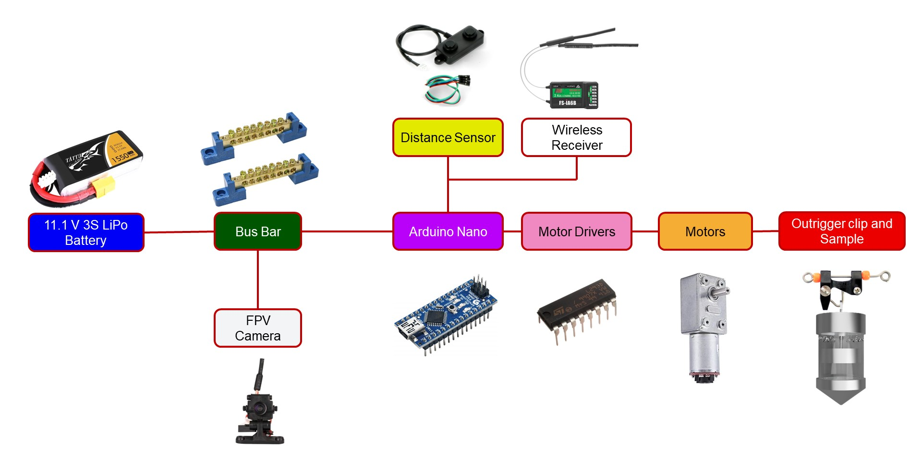
Mechatronic Diagram
Dylan Ma

Slide 30
Testing Workbench
Motor Specs
Storage and Seal
Dylan Ma

Slide 31
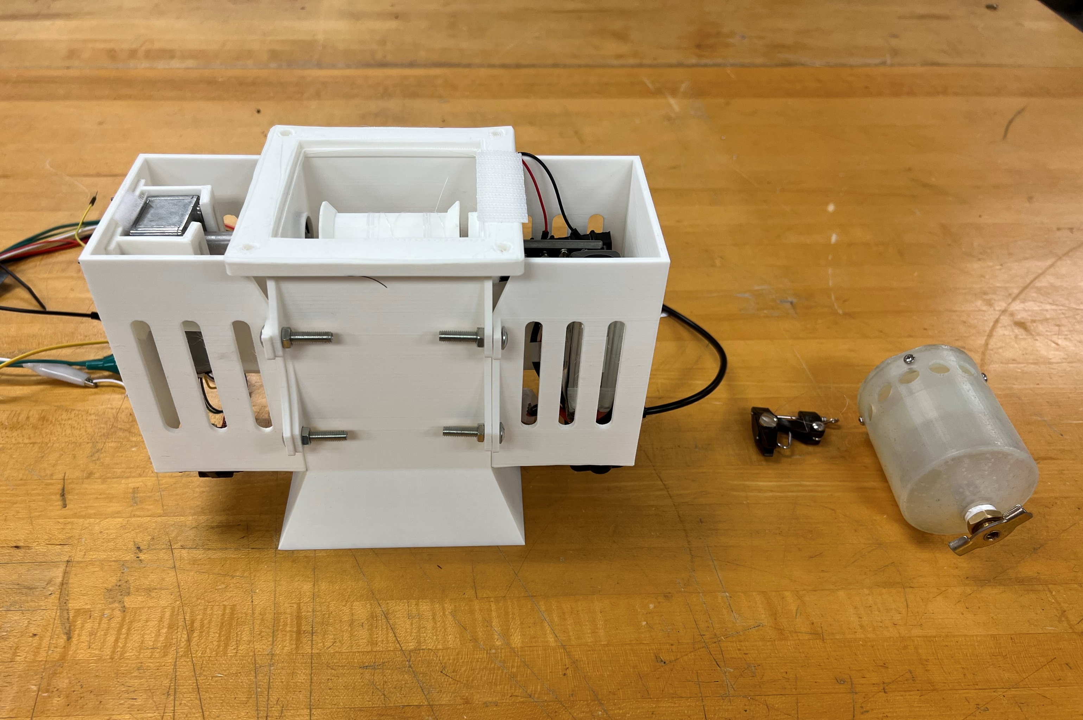
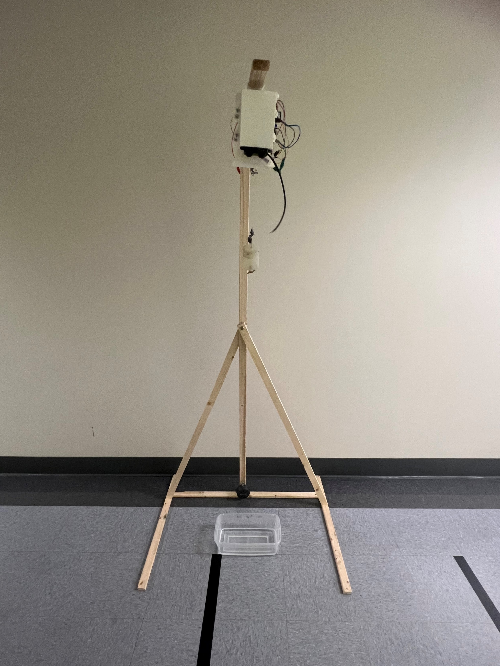
Experimental Setup
Housing with holes for wires
1.82 m
Outrigger clip and Sampling Apparatus
Dylan Ma

Slide 32
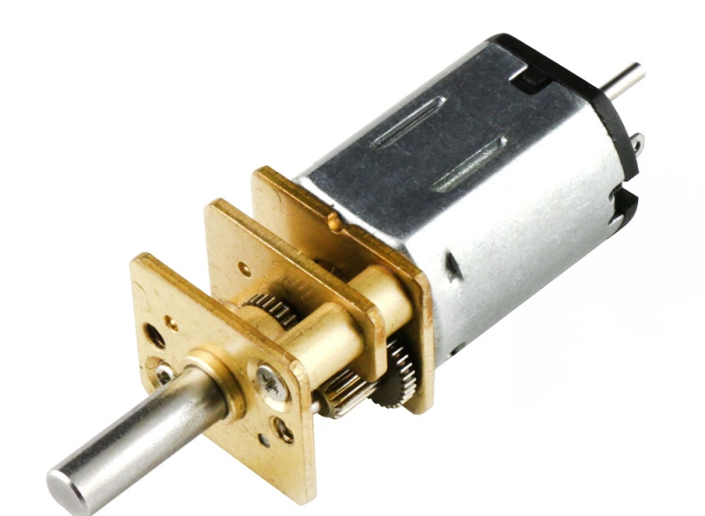
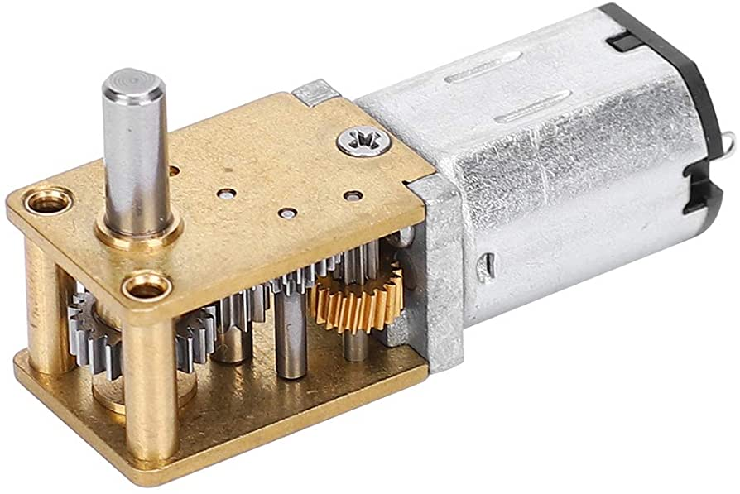
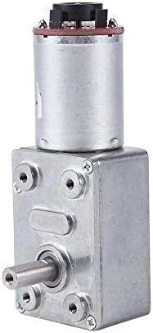
Testing Motor Specs
Motor Model | Rated Torque | Speed (1.82 m) | Current | Weight | Back-driven? | Encoder?
6V 41 RPM | 2.5 kg•cm | 27 sec | <180 mA | 18 g | Yes | Yes
12V 68 RPM | 1.27 kg•cm | 17 sec | ~85 mA | 18 g | No | No
12V 40 RPM | 5.6 kg•cm | 28 sec | ~100 mA | 156 g | No | Yes
12V 100 RPM | 1.5 kg•cm | 14 sec | ~200 mA | 156 g | No | Yes
Dylan Ma
Notes:
Sick table

Slide 33
Testing Motor Specs
Motor Model | Rated Torque | Speed (1.82 m) | Current | Weight | Back-driven? | Encoder?
6V 41 RPM | 2.5 kg•cm | 27 sec | <180 mA | 18 g | Yes | Yes
12V 68 RPM | 1.27 kg•cm | 17 sec | ~85 mA | 18 g | No | No
12V 40 RPM | 5.6 kg•cm | 28 sec | ~100 mA | 156 g | No | Yes
12V 100 RPM | 1.5 kg•cm | 14 sec | ~200 mA | 156 g | No | Yes
Dylan Ma
Notes:
Sick table

Slide 34
Testing Storage
Prototype Model | Water Stored (mL) | Water Leakage During Ascent?
Design # 1 | 80 mL | Yes
Design # 2 | 90 mL | Yes
Design # 3 | 160 mL | Yes
Design # 4 (Current) | 160 mL | No
Dylan Ma
Notes:
Sick table

Slide 35
Testing Storage
Prototype Model | Water Stored (mL) | Water Leakage During Ascent?
Design # 1 | 80 mL | Yes
Design # 2 | 90 mL | Yes
Design # 3 | 160 mL | Yes
Design # 4 (Current) | 160 mL | No
Dylan Ma
Notes:
Sick table

Slide 36
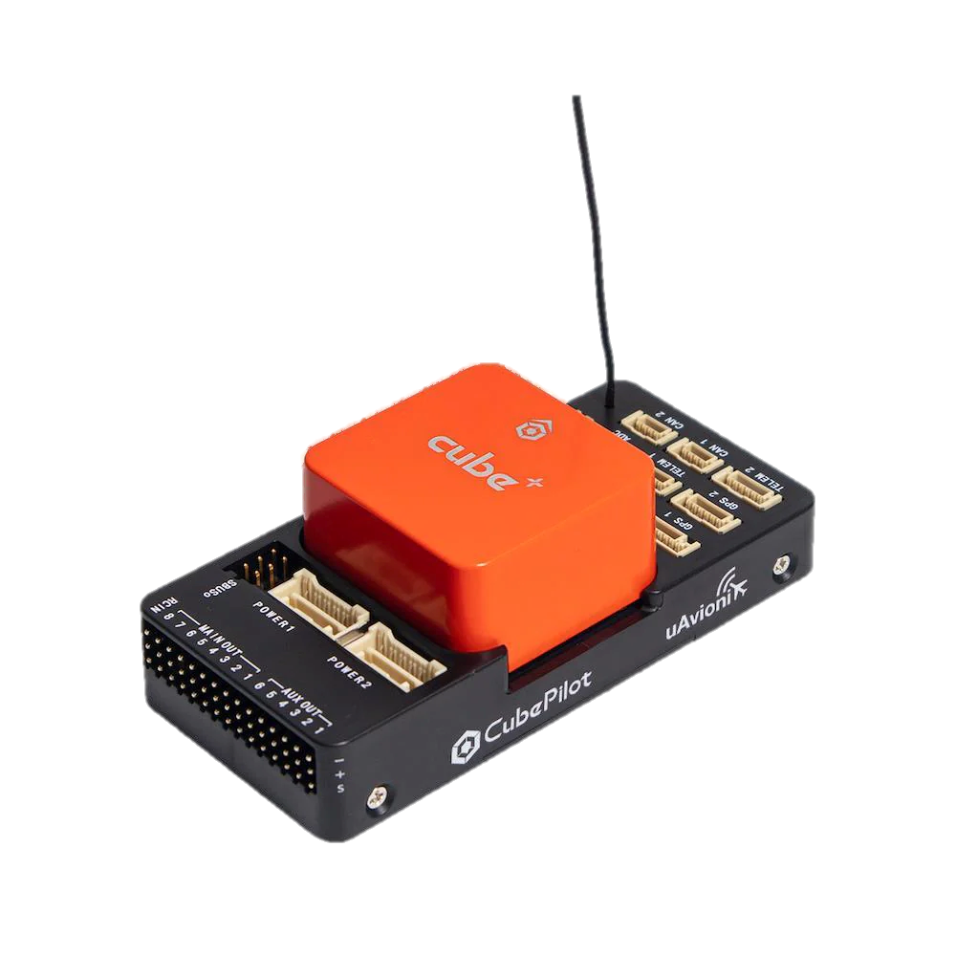
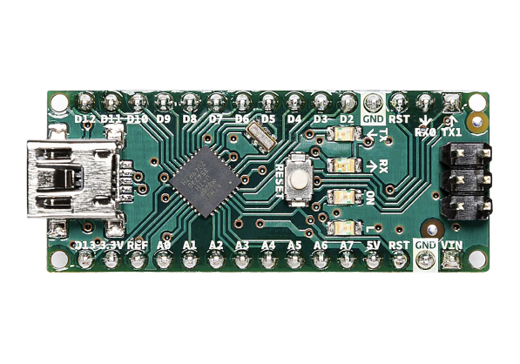
Communication and Integration
Matthew Lancaster
Notes:
The original idea was to connect the microcontroller directly to the flight controller of the drone. And send a digital signal from the flight controller to the MCU when the sampling process was to get started. However, this created issues with universal compatibility. A better solution was found. To discuss this we’ll give a brief summary of how a drone works.

Slide 37
Communication and Integration
Flight Controller
Matthew Lancaster
Notes:
The flight controller is the brains of the drone. However there are hundreds of flight controllers with different features. Some flight controllers can act as receivers but others can not and require additional pieces. This brings us to a challenge. We wanted to make our apparatus universal with minimal work. Heres how we did it.

Slide 38
Communication and Integration
Transmitter
Matthew Lancaster
Notes:
To communicate with a drone, you use a transmitter or more commonly referred to as a controller. The controller uses radio waves typically in the 2.4 and 5.8 Ghz. Now some flight controllers are made to receive this signals without any extra components. But commonly you would use a receiver.

Slide 39
Communication and Integration
Receiver
Matthew Lancaster
Notes:
The receiver works by collecting the signals from controller via the signals the controller outputs. These are typically used to control and operate your drone.

Slide 40
Communication and Integration
Matthew Lancaster
Notes:
So what we decided to do was use a receiver to communicate with the Arduino. What is nice about this option is: Receivers are inexpensive, reliable, and can be used in tandem with other receivers with the same transmitter. It’s as simple as binding a receiver with the transmitter. On the controller you can assign the channels of the receivers to specific switches. This allows our prototype to be compatible with different flight controllers and drone transmitters.

Slide 41
Communication and Integration
Matthew Lancaster
Notes:
So, how does this work? Well…

Slide 42
Communication and Integration
Matthew Lancaster
Notes:
You have your four main controls for flying a drone. You have throttle, yaw, roll, and pitch. These controls are assigned channels and binded to the receiver connected to the flight controller. You can fly the drone with these alone. However,…

Slide 43
Communication and Integration
Matthew Lancaster
Notes:
Most drone transmitters have additional switches that you can assign to specific uses. These are referred to as auxillery channels. The controller listed is the one we are using for our validation and testing. This controller has an additional 6 aux channels free to pair. We will be using two of these channels. The first to start the autonomous sample collection as well as the other for manual control of the collection process. So now we’ll talk about our autonomous collection process.

Slide 44
Feedback and Controller
Input
Controller
Plant
Output
Unity Feedback
Matthew Lancaster
Notes:
Well we are using feedback control to ensure the container collects the correct amount of sample.

Slide 45
Feedback and Controller
Sensors communicate distance to water
Arduino converts distance to encoder steps
Input
Controller
Plant
Output
Unity Feedback
Matthew Lancaster
Notes:
So once our drone is in position and ready to take the sample we trigger the start of the feed back control. The distance sensor measures the distance to the water and then converts this distance to encoder steps.
Automatic not autonomous? Look up levels of autonomy in robotic systems.

Slide 46
Feedback and Controller
Currently using PD controller
MATLAB limits the oscillations via optimal motor output
Feedback Control: the trajectory is updated over time
Input
Controller
Plant
Output
Unity Feedback
Matthew Lancaster
Notes:
We are currently using a PD controller to drive the motor. However, we are also working on implementing an optimal controller. The optimal controller uses MATLAB to limit oscillations via optimal motor output. This would change the duty cycle sent to the motor every timestep to limit the oscillations of the sample as it is being retrieved. After the controller decides what is needed to drive the motor. The signal is passed to the plant.

Slide 47
Feedback and Controller
12V Worm Gear Motor GR: 60:1
Hall effect encoder with 5320 resolution
Input
Controller
Plant
Output
Unity Feedback
Matthew Lancaster
Notes:
The plant in this diagram is our motors. The thing being controlled. We are currently using a DC motor with encoder and attached gear box. The gear box features a 40:1 gear ratio which means that the motor has an output of one revolution for every 40 revolutions of the input shaft. The gear box also outputs directly to a worm gear which makes the motor nearly impossible to back drive. This is essential saving power after collection as the motor can be “turned off” Once the motor receives the signal it outputs a certain value which is then

Slide 48
Feedback and Controller
Output is duty cycle sent to motor
Feedback is sent to summing junction
Distance error is minimized by PD Controller
Input
Controller
Plant
Output
Unity Feedback
Matthew Lancaster
Notes:
Sent back as the current state of the motor. This value through the summing junction where the desired position and the current position are compared to create the error amount. This error amount is entered into our controller that then proportionally increases or decreases the duty cycle based on how far away we are from our target.

Slide 49
Feedback and Controller
Averaging less than 1% of error
This translates to 50 encoder steps
With current spool diameter, the error is 1.5 mm
Input
Controller
Plant
Output
Unity Feedback
Matthew Lancaster
Notes:
Currently we are averaging less than 1% of error. Which translates to roughly 50 encoder steps or 1.5 mm. At the current size of the sample and distances being sampled. This error is negligible.

Slide 50
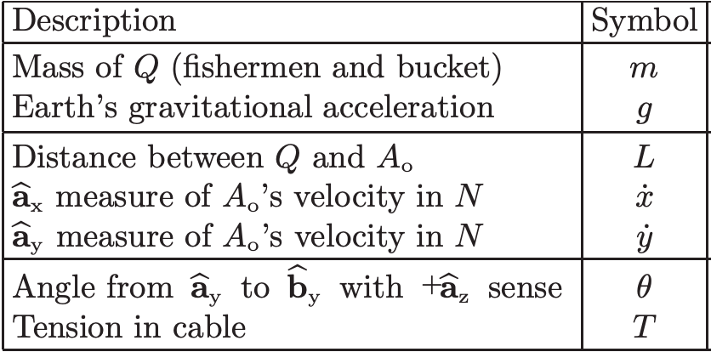
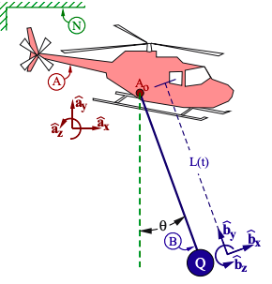
"The Spaghetti Effect"
How to limit the oscillation of sample when pulling it out of the water?
Roberto Lacasa
Notes:
The highlighted equation is the full dynamics of the system.
When the helicopter (drone) is stationary, the x and y double-dot (acceleration in the x and y) are zero
and the equation simplifies to the one below (green), where we can solve for theta double-dot (angular acceleration) (cyan)
It can be seen from the cyan equation the value for angular acc increases as the term in the denominator (cable length) gets smaller.
This shows us that the oscillations to the sample at the end of the cable can increase significantly as the sample is raised towards the payload, especially at the very top.

Slide 51
Simulations
Roberto Lacasa
Notes:
The spaghetti effect can be show in the following animations, this shows the uncontrolled sample

Slide 52
Simulations
Roberto Lacasa
Notes:
The sample animation with feedback controllers on it.

Slide 53
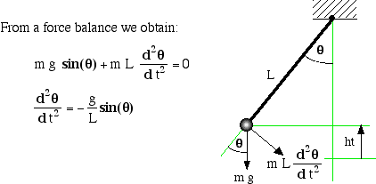
Controls Design
The system dynamics can be modeled as a 2-D pendulum
Pendulum has nonlinear dynamics
Roberto Lacasa
Notes:
Nonlinear: a change in input (theta) does not yield a mathematically "linear" output (angular acc.) due to the sin wave function

Slide 54
Controls Design
Linearly approximated system was uncontrollable
The system must be controlled with nonlinear dynamics
Trajectory Optimization with feedback control: Model Predictive Control (MPC)
Roberto Lacasa
Notes:
Make sure to explain how linear approximation is done and what controllability means
Linear approx : taking plots based off of a fixed point: where velocities and accelerations are = 0
Controllability means: you can move from any starting initial conditions to any arbitrary state of our choosing (or a zero state).
Dr. Hubicki suggests using a T.O. w/ feedback control: MPC

Slide 55
Model Predictive Control
Roberto Lacasa
Notes:
Make sure to explain linear approximation and what controllability means
Controllability means: you can move from any starting initial conditions to any arbitrary state of our choosing (or a zero state).

Slide 56
Model Predictive Control
Measured Disturbances
References
Measured Outputs
Optimizer
Plant
Prediction Model
Control Moves
MPC
Roberto Lacasa

Slide 57
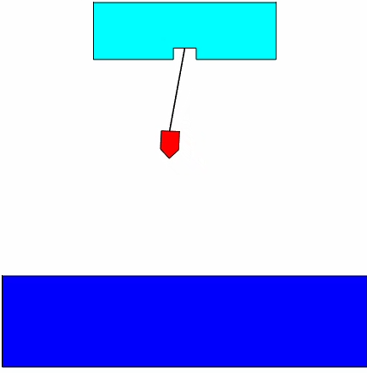
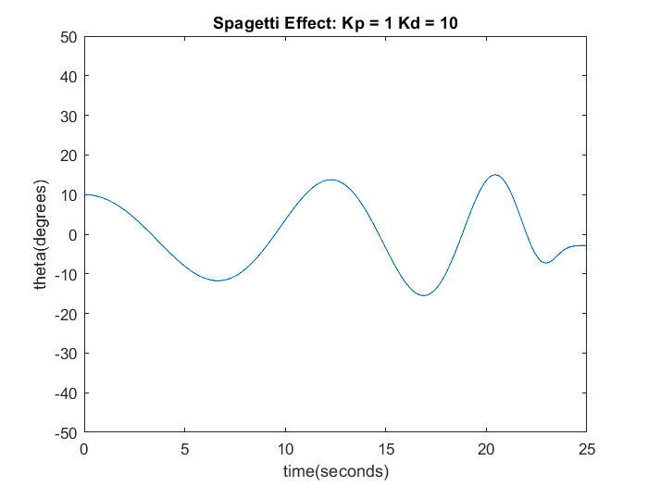
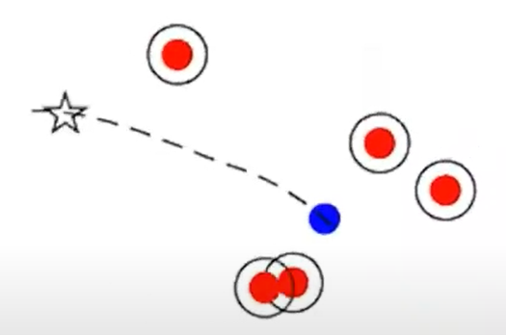
Model Predictive Control
Short Term Goals | Run MATLAB script that returns optimal trajectory using feedback control Obtain animation and plots
Long Term Goals | Integrate trajectory optimization to work with payload motor and drone camera wirelessly MPC Drone Example
Roberto Lacasa

Slide 58
Refined Prototype
Drone Payload Sample and Collection Work Breakdown Structure
Refined Storage Prototype
Design Review 6
3D Print housing
Assemble all components
Assemble housing
Integrate flight controller with receiver
Mount housing to drone body
Completed Testing
Roberto Lacasa

Slide 59
Refined Prototype
Drone Payload Sample and Collection Work Breakdown Structure
Refined Storage Prototype
Design Review 6
3D Print housing
Assemble all components
Assemble housing
Integrate flight controller with receiver
Mount housing to drone body
Completed Testing
Roberto Lacasa

Slide 60
Budget Costs
$ 532.76
$ 1087.45
$ 332.82
$ 46.97
Roberto Lacasa

Slide 61
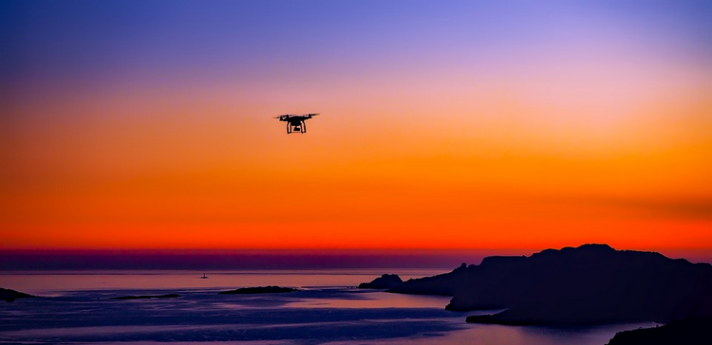
Questions?
Upcoming Milestones
Roberto Lacasa

Slide 62
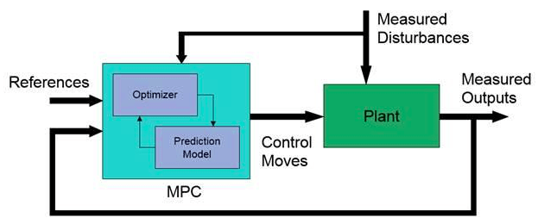
Model Predictive Control
Roberto Lacasa

Slide 63
Backup Slides

Slide 64
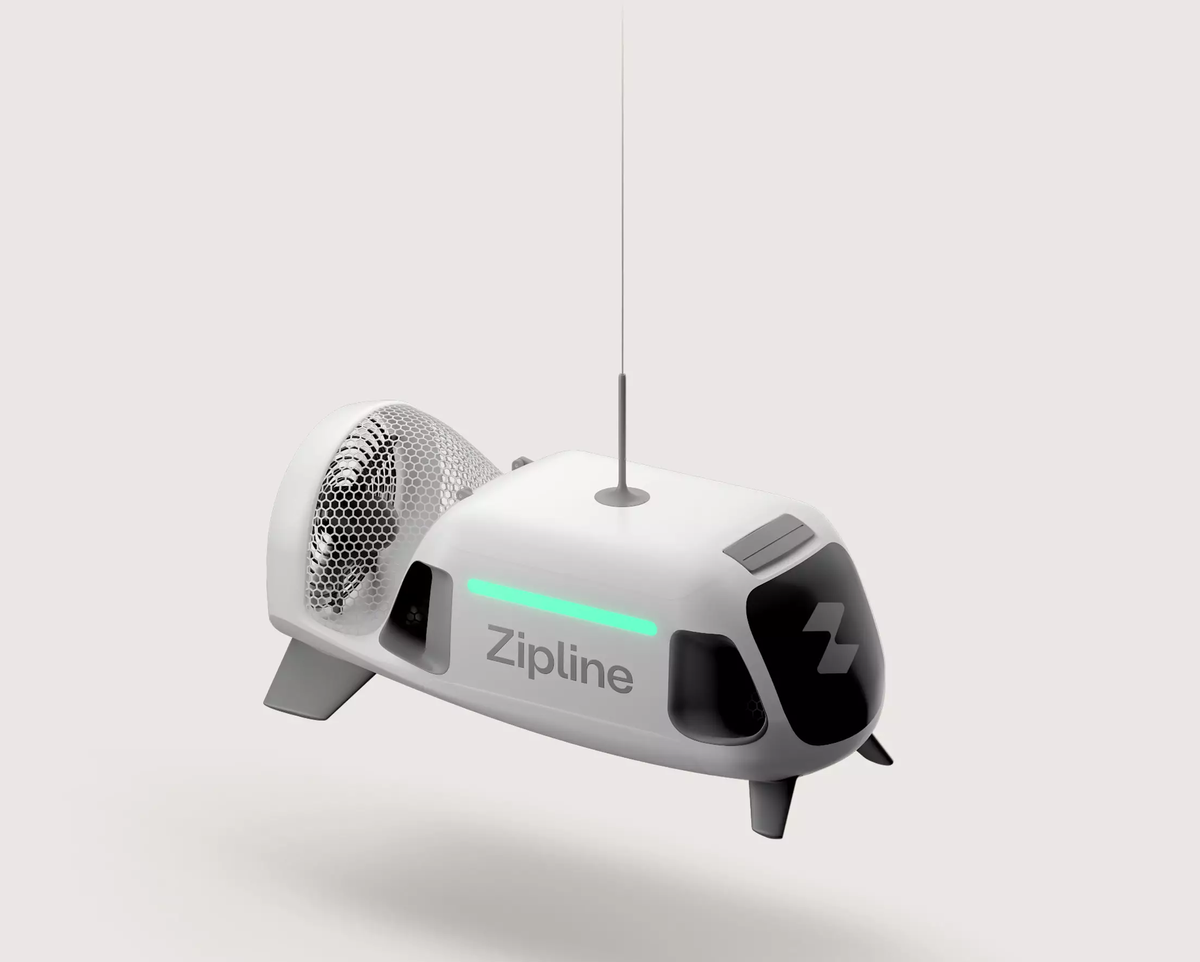
Current Market
Currently delivering in united states
Autonomous flight with precise ETAs
Average order time of 18 minutes
Dominic Bellocchio
Notes:
https://www.youtube.com/watch?v=DOWDNBu9DkU&t=273s
The picture is of the package holder that is lowered beneath the drone and delivers the food/purchase. I think this one is more commercial and profitable

Slide 65
Budget Costs
$ 532.76
$ 1087.45
$ 332.82
$ 46.97
Roberto Lacasa

Slide 66
Budget Costs
Roberto Lacasa

Slide 67
Budget Costs
$ 36.97
$ 305.94
$ 538.57
$ 78.97
$ 49.01
Roberto Lacasa

Slide 68
Testing and Validation
Include significant results and things learned + improvements
Table of components we ran through
Motors specs
Lipo battery
Motor
Sample
Battery based on power
Dylan Ma

Slide 69
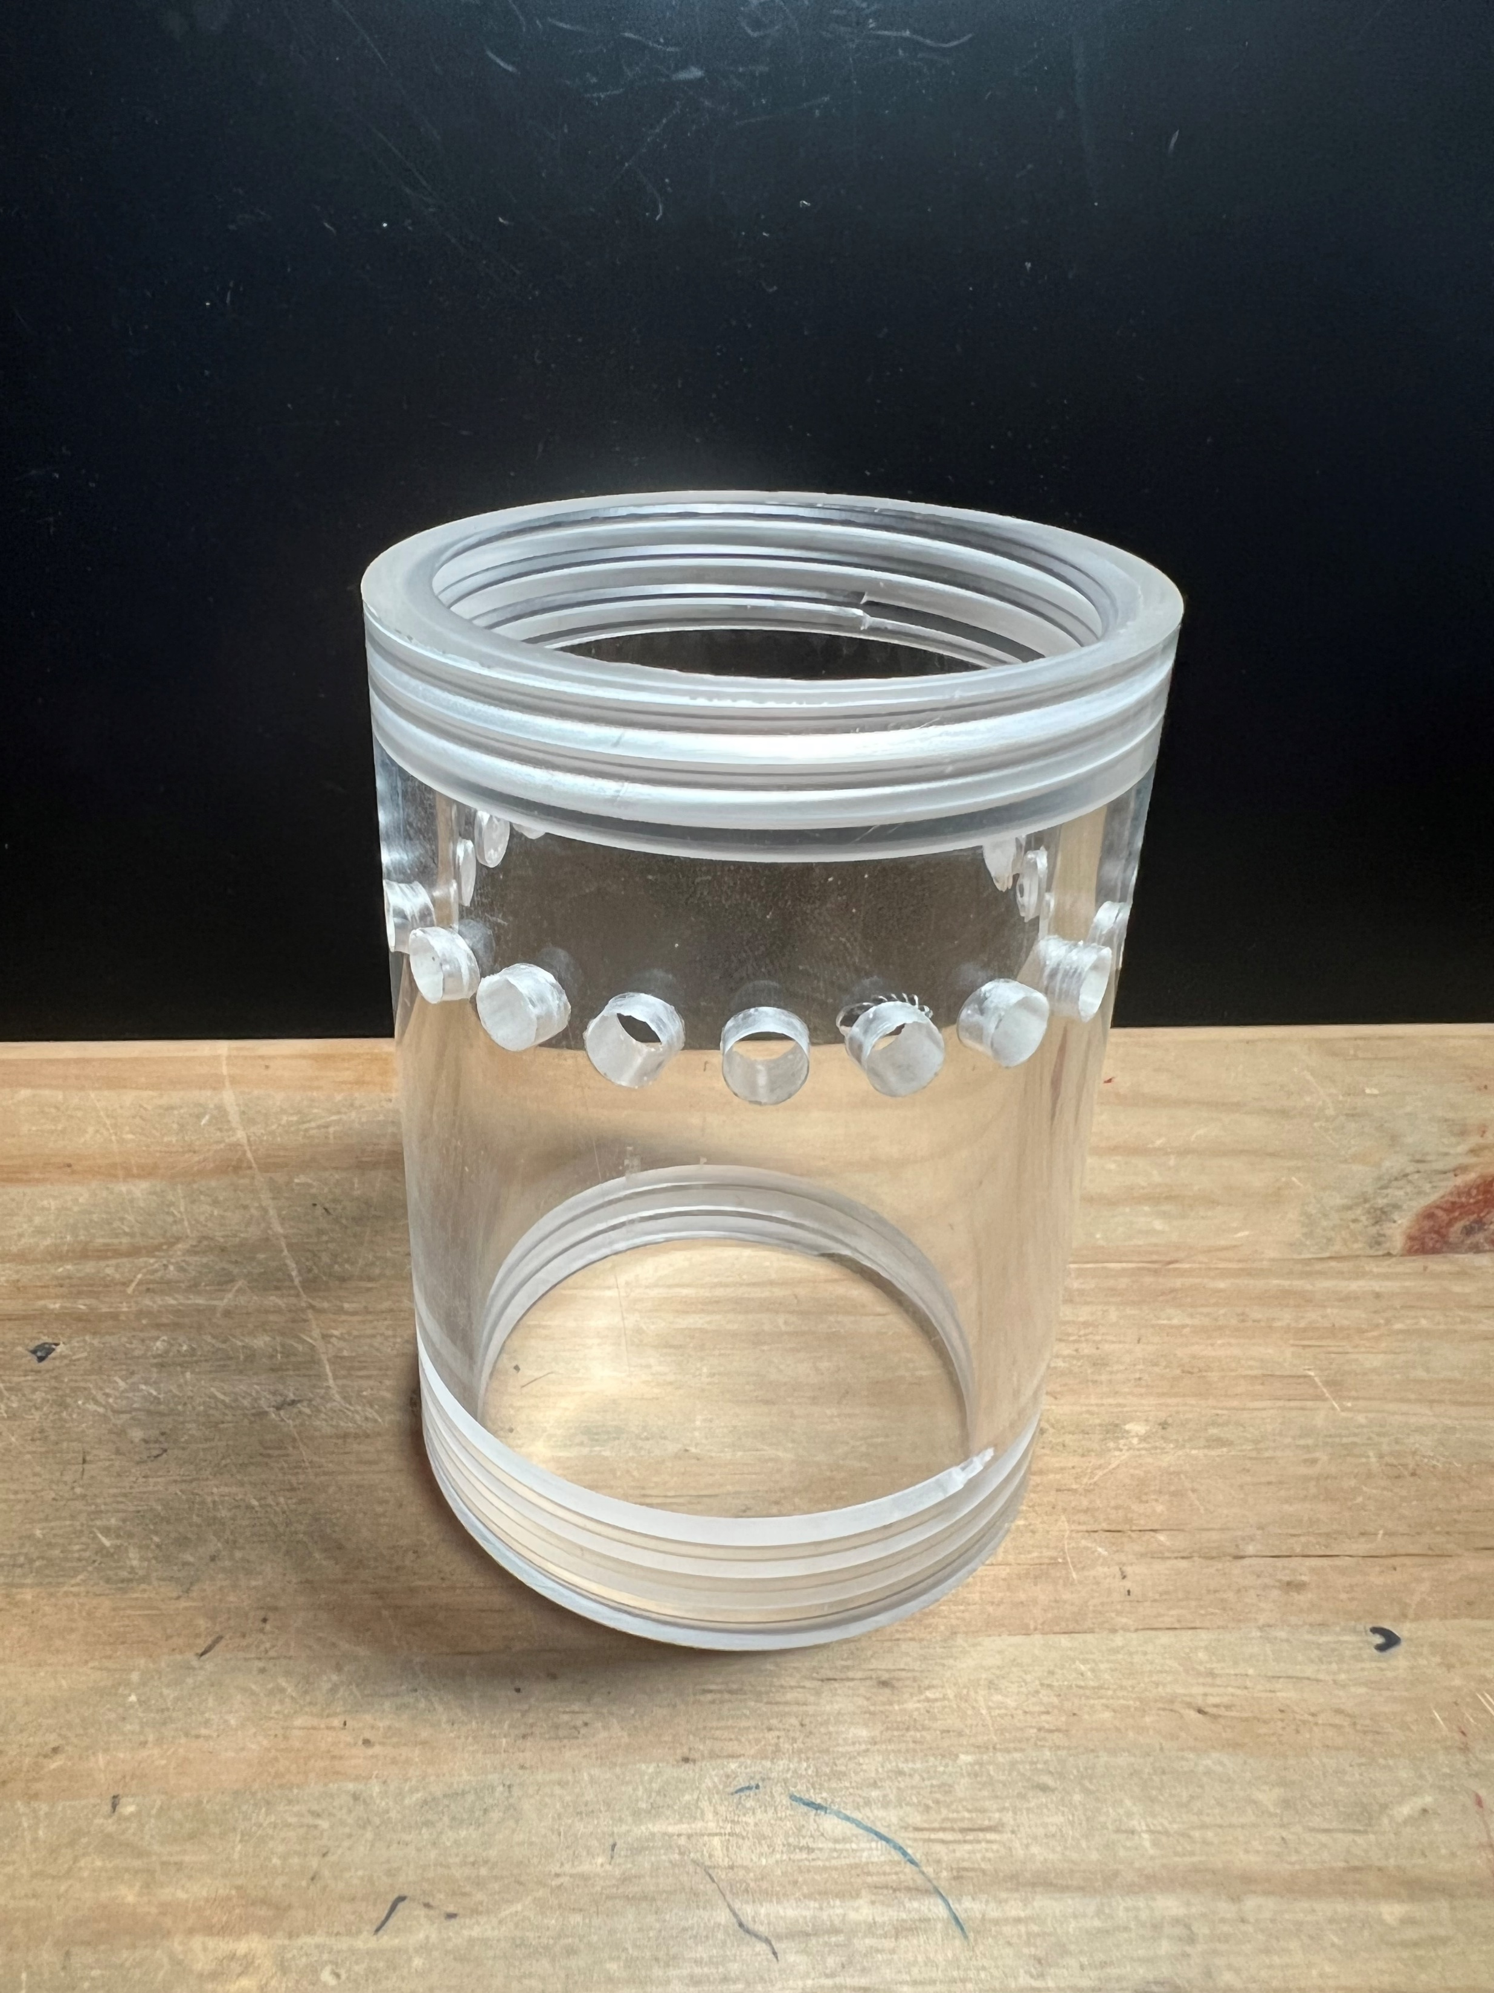
Design #3 Dimensions
95 mm
70 mm
Dylan Ma

Slide 70
Design #3 Overview
Threaded ends allow for screwed caps
Smaller holes to increase wall strength
Clear cast acrylic holds ~150-160 mL
Dylan Ma
Notes:
Greater factor of safety (x1.5) used to obtain an adequately sized sample +- some. Some issues: holes were made smaller to improve integrity of the container walls, but difficulty letting in algae. Threads were included to screw caps on and allow for easy replacement of parts/ testing sample, but hard to thread acrylic cast tubing. Did not turn out perfectly, and hard to remove caps. For next design, increase holes again, and add valve to bottom of the container to let water and algae out.

Slide 71
Budget Costs
$ 36.97
$ 158.04
$ 205.83
Matthew Lancaster

Slide 72
Budget Costs
$ 305.94
Matthew Lancaster

Slide 74
Refined Prototype
Drone Payload Sample and Collection Work Breakdown Structure
Refined Sample Prototype
Initial Storage Prototype
Design Review 5
Waterproof testing
Design Compact Walls
Finalize testing
Assemble Prototype
Design space for inner components (motor, spool, etc.)
Finalize Prototype 1
Order dimensionally correct parts
Dimension area used
Combine Prototypes
Matthew Lancaster

Slide 75
Refined Prototype
Drone Payload Sample and Collection Work Breakdown Structure
Refined Sample Prototype
Initial Storage Prototype
Design Review 5
Waterproof testing
Design Compact Walls
Finalize testing
Assemble Prototype
Design space for inner components (motor, spool, etc.)
Finalize Prototype 1
Order dimensionally correct parts
Dimension area used
Combine Prototypes
Matthew Lancaster

Slide 76
Refined Prototype
Drone Payload Sample and Collection Work Breakdown Structure
Refined Sample Prototype
Initial Storage Prototype
Design Review 5
Waterproof testing
Design Compact Walls
Finalize testing
Assemble Prototype
Design space for inner components (motor, spool, etc.)
Finalize Prototype 1
Order dimensionally correct parts
Dimension area used
Combine Prototypes
Matthew Lancaster

Slide 77
Refined Prototype
Drone Payload Sample and Collection Work Breakdown Structure
Refined Sample Prototype
Refined Storage Prototype
Initial Storage Prototype
Design Review 5
Design Review 6
Waterproof testing
3D Print housing
Design Compact Walls
Assemble all components
Finalize testing
Assemble Prototype
Design space for inner components (motor, spool, etc.)
Integrate flight controller with Arduino
Assemble housing
Finalize Prototype 1
Order dimensionally correct parts
Mount housing to drone body
Dimension area used
Completed Testing
Combine Prototypes
Matthew Lancaster

Slide 78
Budget Costs
Matthew Lancaster
Notes:
Note that also need to create a spring project plan before the semester is over.
In terms of prototyping: Toyota's motto is: "tape it, glue it, weld it" this is how we are going to approach prototyping.
We also will create and present a poster of the project's updates

Slide 79
Mechatronics and Controller
DC micro motor, GR: 236:1
Hall effect encoder with 5320 resolution
Input
Controller
Plant
Output
Unity Feedback
Matthew Lancaster

Slide 80
Refined Prototype
Drone Payload Sample and Collection Work Breakdown Structure
Housing
Integration
Design Review 5
3D Print housing
Begin
Finalize testing
Assemble housing
Design space for inner components (motor, spool, etc.)
Finalize Prototype 1
Mount housing to drone body
Dimension area used
Combine Prototypes
Matthew Lancaster

Slide 81
Refined Prototype
Drone Payload Sample and Collection Work Breakdown Structure
Refined Sample Prototype
Initial Storage Prototype
Design Review 5
Waterproof testing
Design Compact Walls
Finalize testing
Assemble Prototype
Design space for inner components (motor, spool, etc.)
Finalize Prototype 1
Order dimensionally correct parts
Dimension area used
Combine Prototypes
Matthew Lancaster

Slide 82
Mechatronic Systems
Test circuit in tandem with Arduino for remote operation
Tauben Brenner
Notes:
The payload should be as light as possible, to reduce power consumption, reduce material costs, and minimize effects of weight imbalances on the drone.

Slide 83
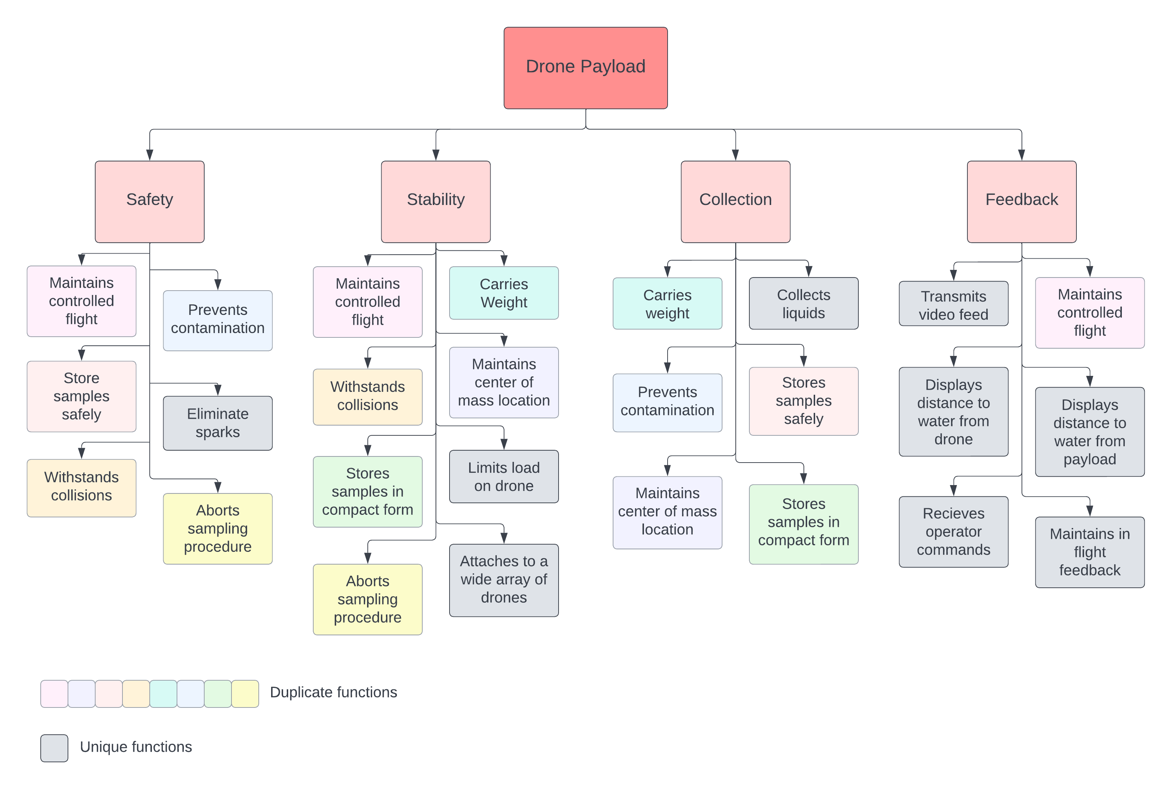
Functional Decomposition

Slide 84
Functional Decomposition

Slide 85
Functional Decomposition

Slide 86
Functional Decomposition

Slide 87
Functional Decomposition

Slide 88
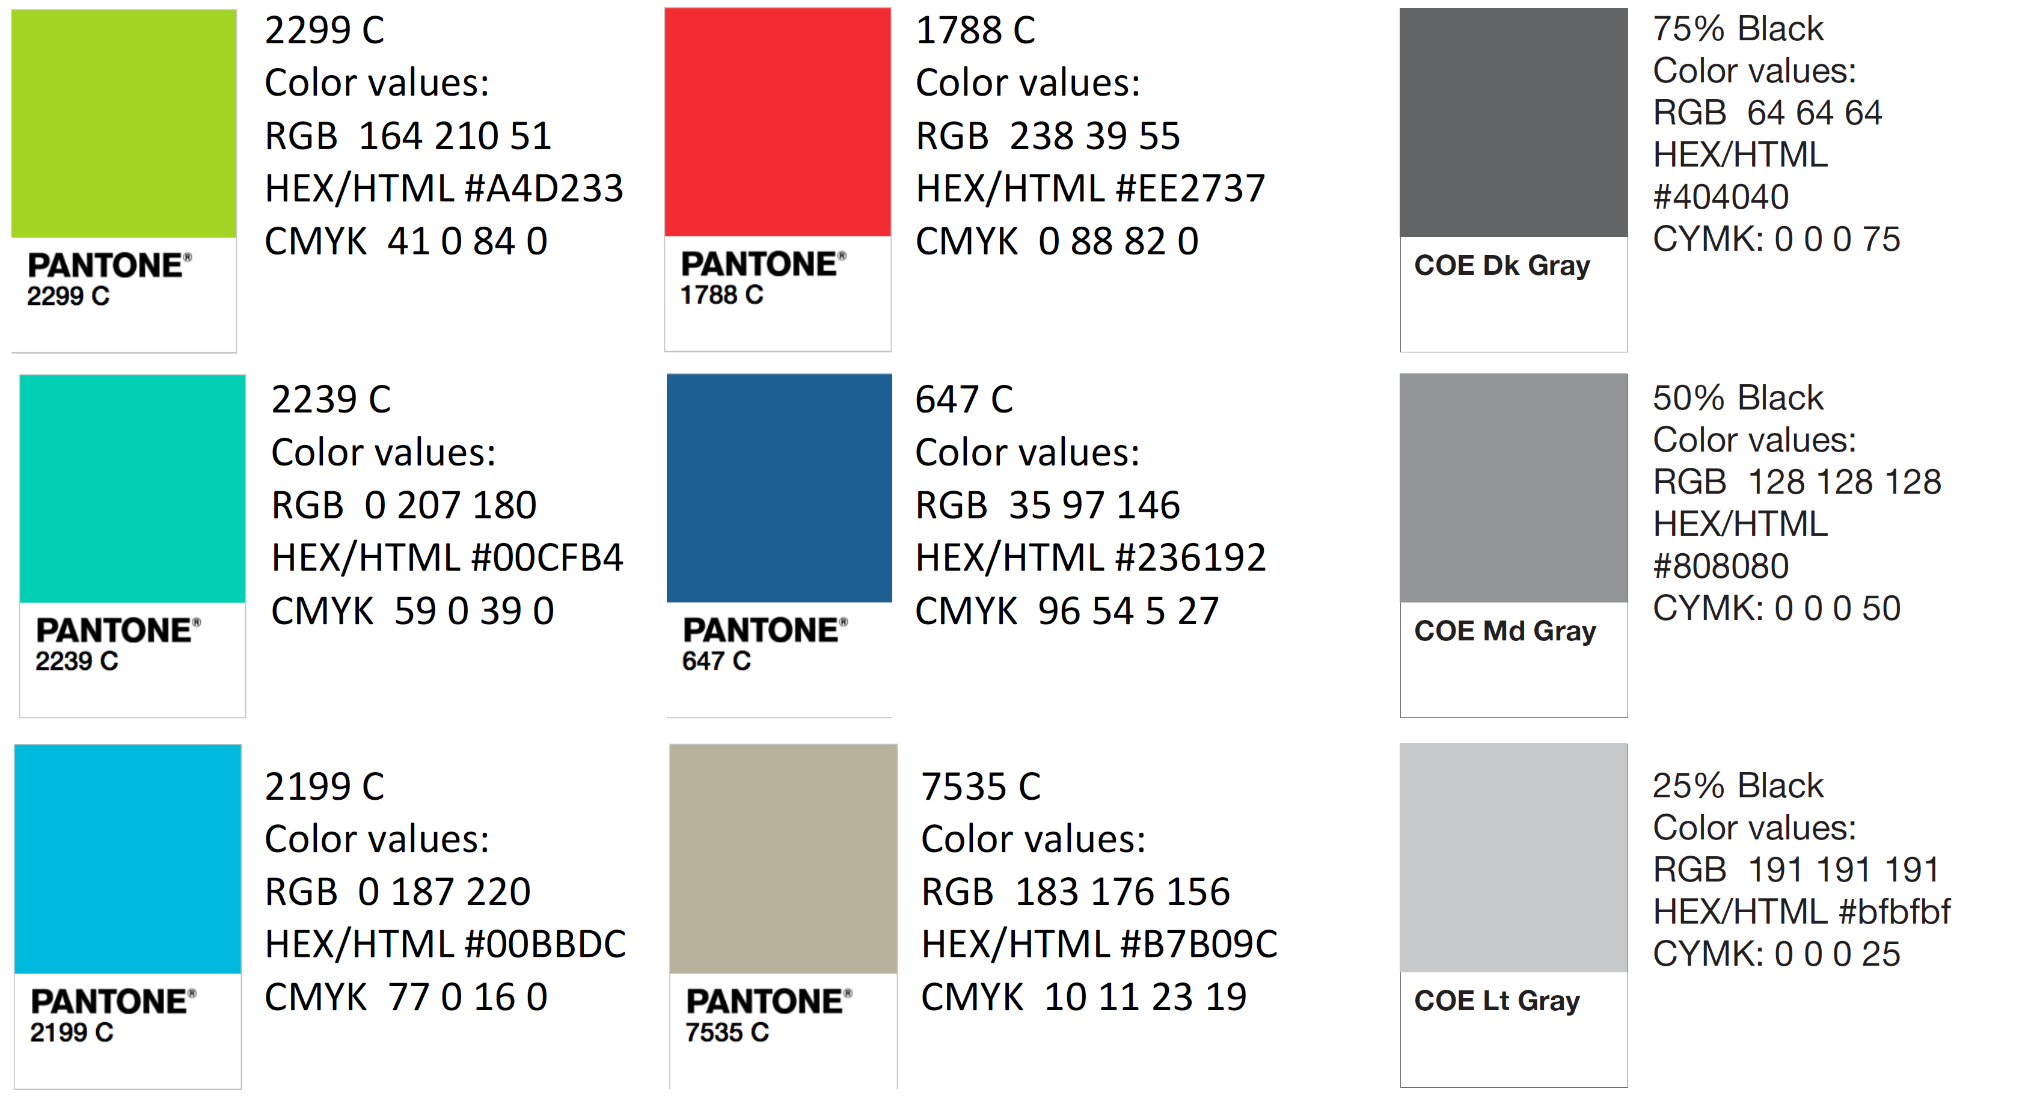
Color Palette

